Slide 1
Winnersh Primary School Foundation Stage Curriculum Information

Slide 2
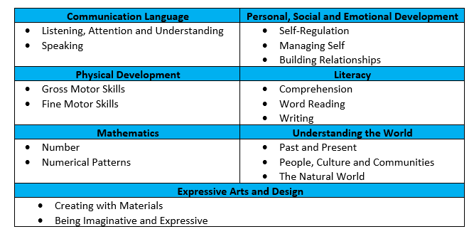
Early Years foundation stage New curriculum 2020
E
Early Learning Goals

Slide 3
Early Years Foundation Stage Profile
E
In June, your child will be assessed against these Early Learning Goals (ELGs).
These show readiness for Year One – your child will be given ‘emerging’ or ‘expected’.
These are not tests, but judgements. We use our knowledge of your child’s achievements, gained throughout the year during exploring time as well as adult led activities.
We will send out information about ELGs at spring parents’ evenings.

Slide 4
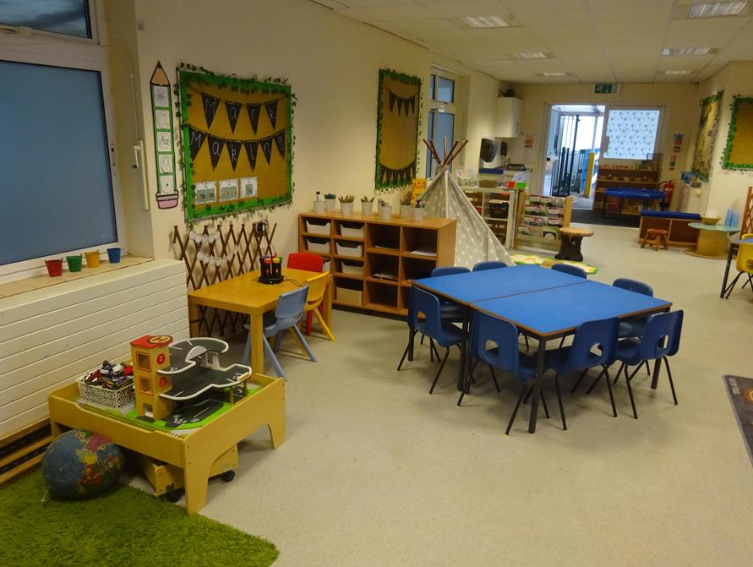
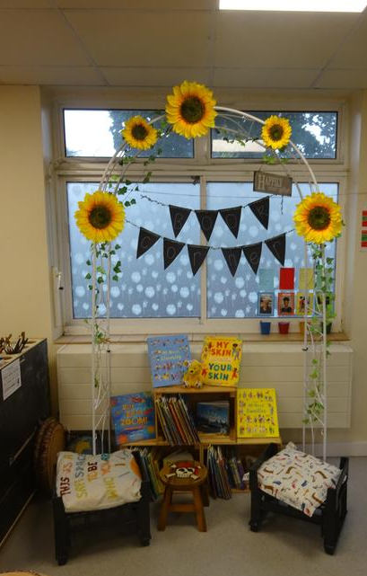
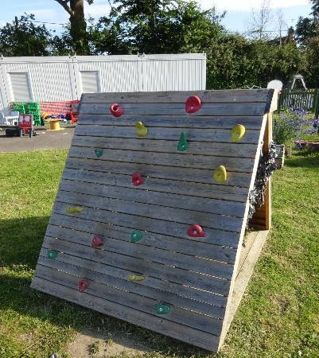
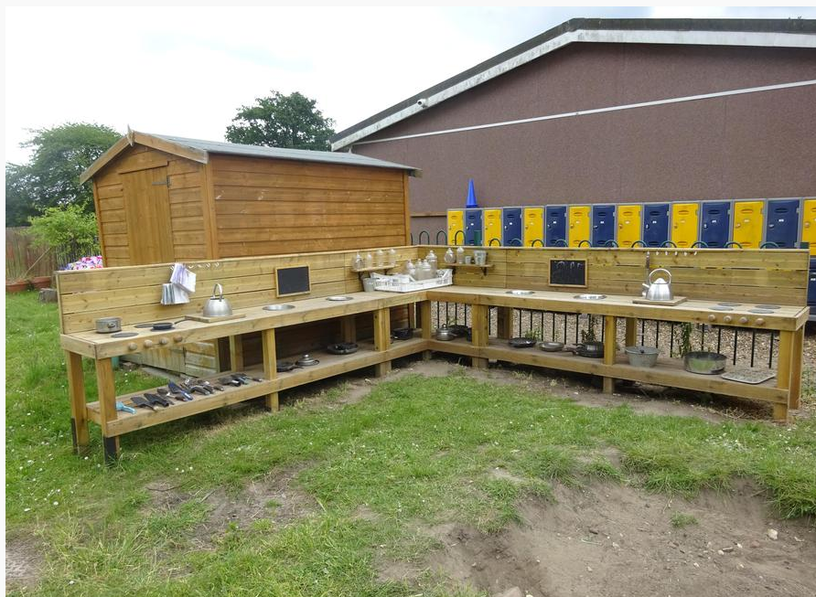
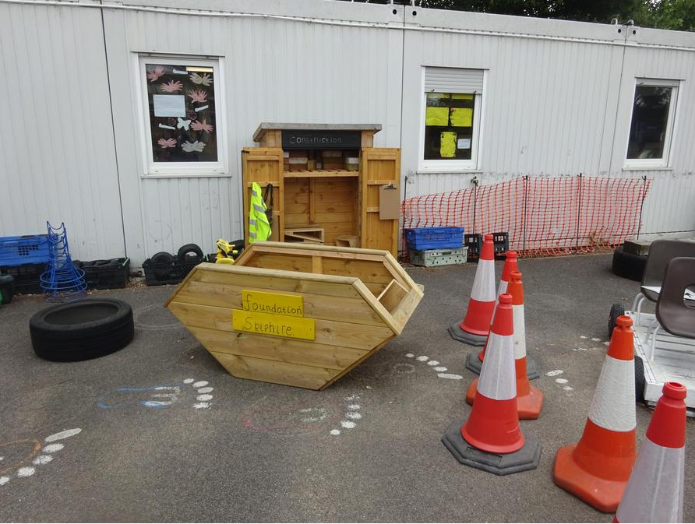
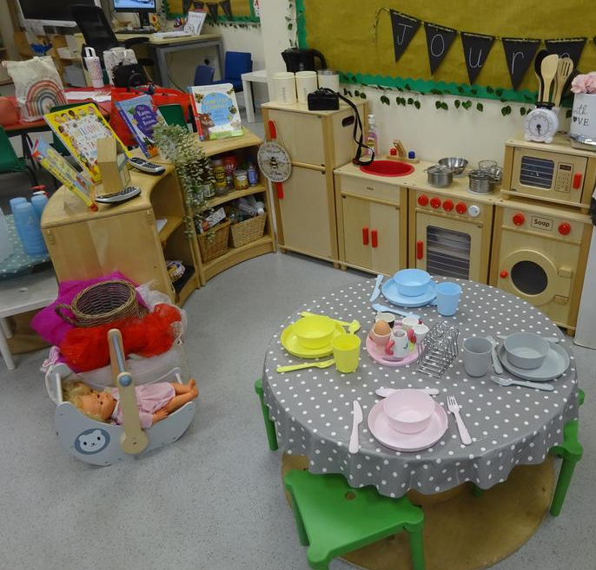
Learning Environments
M
Inspire and guide children’s imagination through open ended play opportunities
Connecting to nature
Focus on developing language
Focus on sustainability

Slide 5
Topics and Workshops/Trips
M
Autumn 1 – Marvellous Me!
Autumn 2 – Blast off! and Christmas
Spring 1 – Dinosaurs Roar
Spring 2 – Once upon a time
Summer 1 – Pirates
Summer 2- Nature Detectives- Trip to Wellington Country Park

Slide 6
Behaviours and Expectations
M
In Foundation Stage we encourage the children to try their best, listen to each other and staff, be polite, use kind hands and feet and use kind words to each other.
Children agree class rules and we have created a class charter.
Therapeutic thinking: Whole class rewards (stars in a jar) and children vote for their reward , this could be extra time on the adventure playground , watching a short film or having a nice treat ( biscuit)
Children have been allocated a house ( Benjamin, Latif, Attenborough and Sharman) and will collect house points.
We give out certificates linked to our school values: Show respect, Get involved and Embrace challenge.

Slide 7
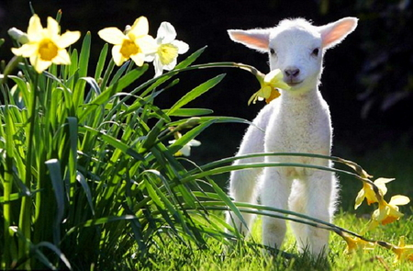
Celebrating events in the world
M
We also plan activities linking to the children’s interests and events in the world.

Slide 8
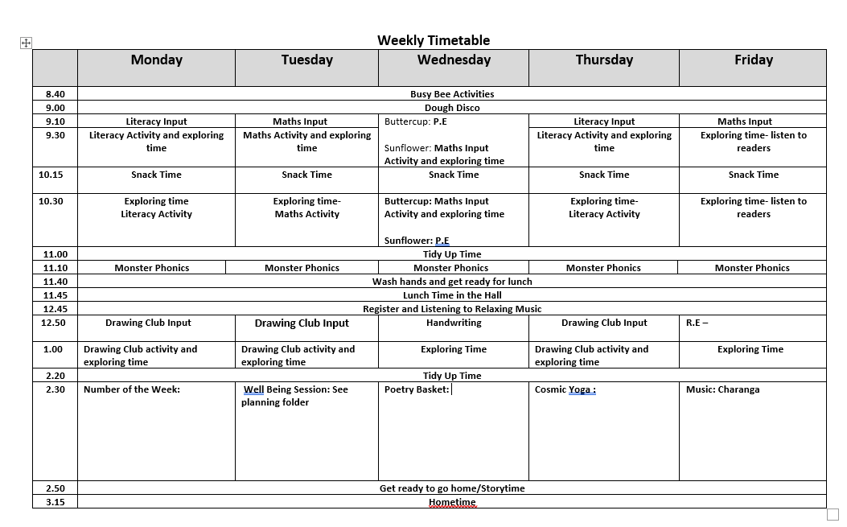
Timetable
E

Slide 9
Eating and drinking at school
M
Please bring in a named water bottle each day.
Fruit snacks are provided by the government fruit for schools scheme. However if your child prefers to bring in a snack from home, please ensure this is a piece of fresh fruit only and that it is in a named container/tub.
All children under 5 are entitled to free milk; once they are 5 you can pay to opt in.
Lunches are pre-ordered.
If your child has packed lunch, no nuts, sweets or chocolate bars please (a chocolate biscuit is fine, eg a penguin).

Slide 10
PE
M
PE is on Wednesday mornings and is taught by Mrs Sidhu. The classroom TAs stay to support at PE time.
Children are encouraged to get changed independently. Please help with this by practising at home.
(Please make sure EVERYTHING is named)
We will send home PE kits at the end of a half term.
Autumn 1 : Getting changed and Fundamental Moving Autumn 2 : Dance and Gym
Spring 1: Movement and Handling | Spring 2: Ball skills/Racket sports
Summer 1: Run, jump and throw | Summer 2: Ball skills- Hit, Run and Catch.

Slide 11
What is exploring time?
E
Free-flow independent play and planned exploration opportunities within the indoor and outdoor learning environments – please send them in wearing a coat each day.
Children self-select resources, practise new ideas and skills; they take risks, show imagination and solve problems.
Focus on developing a love of learning, independence and resilience.
Adults support children during exploring time through discussions, questioning and reflection to support and extend learning and development.
Children also take part in planned small group adult-lead Literacy and Mathematics activities while other children are exploring.

Slide 12
RSE – Relationships and sex education
E
In 2020 the Government asked all schools to update and consult with parents about their RSE policy.
In EYFS we talk about changes, such as how they have changed since a baby and what they can do now.
Towards the end of the year, we talk about changing and growing older and moving into Year 1.
Children will also be taught the scientific words for their body parts e.g womb, testicles, penis.
A letter will be sent out closer to the time explaining the lesson and subject content.

Slide 13
Home learning and communication
M
Home learning is set on Google Classroom every two weeks.
We set it on a Friday and ask for it to be submitted a week on Monday. We will also include a section for ‘wow moments’.
You will be given log ins for Google Classroom and Purple Mash
We will change reading books on Mondays, Wednesdays or Fridays. Please send them into school everyday.
Please sign the Reading Record when you have heard your child read.
We will send out a half-termly newsletter with information and key dates about the half-term ahead. Other information will be sent by parent mail.

Slide 14
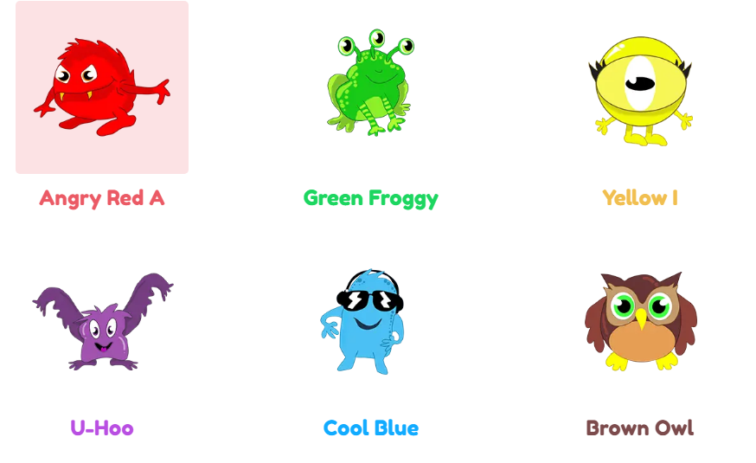
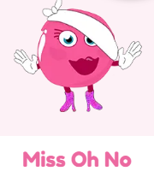
E
Monster Phonics teaches children how to read (blend) and write (segment) by using 10 monsters to categorises all sounds into 10 simple areas. Furthermore, each monster has a different colour and that colour represents that way of spelling the sound.

Slide 15
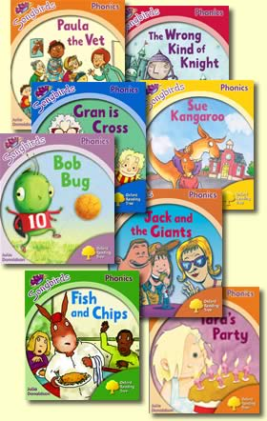
Reading Books
E
Most children start with a lilac book – these have no words. These are to help develop story telling and comprehension. We will also send home phonic flashcards for you to practise with your child – recognising and blending. We will send the next set home when we feel your child is ready to move on. Every child is on their own journey; it is not a race. Children will start taking books with words home when they have started to develop their blending skills. We will read at school with your child every Friday and reading books will be changed 3 times a week.

Slide 16
Reading comprehension
E
What will happen next?
Look at page ____. What do you think might happen?
Have you ever…?
Tell me how the character is feeling.
Do you know another story where …?
Who are the characters in the story? Tell me about … character.
Can you tell me what happened at the beginning and end of the story?
What do you think the character should have done? What would you do?
Who is the story about?
What did you like about the story?
Does it remind you of anything you have done?

Slide 17
How to help your child with literacy
E
Be a role model – let them see you reading and writing.
Talk about what you have read or seen – encourage them to use full sentences.
Don’t be afraid to use new words and vocab – any child who can say ‘velociraptor’ can pick up new words!!! Challenge and inspire them with new words and encourage them to ask what something means if they don’t understand.
Fine motor activities:
Threading, drawing, using dough, tweezers, a stylus for the tablet, pouring and scooping measurements, cutting, pegging – anything that requires small pincer grip.
Encourage early mark making – this may look like lots of lines, random letters and ‘scribble’ but to your child, it has real meaning. Get them to tell you what they have written.

Slide 18
Drawing Club
E
Our youngest writers in the EYFS begin to develop their skills though Drawing Club.
This approach is a fabulous way to promote the magic of stories and enables those stories to be brought to life.
This is done by using mathematics, physical development, language, creativity, imagination, collaboration and most importantly, joy. It has been hugely successful over the first academic year; we have seen a significant impact on children's confidence, imagination, their abilities to express themselves and their fine motor skills. This has been achieved through adult-directed input three times a week, focusing on different elements of a story or animation such as a character, setting or adventure time. After the story has been shared, the children create a 'passcode' to make something truly magical happen to their drawing, using their mathematical and phonetic skills. This could be the initial of their name makes the Big Bad Wolf turn into a baby, or that the number 4 makes a forcefield appear around all the houses that the Three Little Pigs built so they can't be destroyed. As the children's confidence develops and they begin to learn more sounds, they are encouraged to apply this knowledge to their passcodes and they naturally begin to write a word or simple caption. This approach opens up a whole new world of possibilities for the children to explore, enabling adults to help develop and promote a language-rich environment.

Slide 19
How to help your child with maths
M
Spot numbers when you are walking/driving around.
Estimate how many lamp posts you will walk past.
1-1 matching eg 1 plate for mummy, 1 plate for Bob.
Counting numbers in order.
Numeral recognition and putting in order.
1-1 accurate counting of amounts. Put them in a line to count.
Numberblocks and colour blocks on cbeebies are great at reinforcing the learning that has taken place at school.
Use comparison vocab eg length, weight, height.
Positional language eg put the teddy on the table.
Use words ‘more’, ‘less/fewer’.
Real life problems eg I have 6 sweets, Bob gives me 2 more.
Looking at numbers on scales and packaging when cooking.
Notes:
Subitising, number of the week

Slide 20
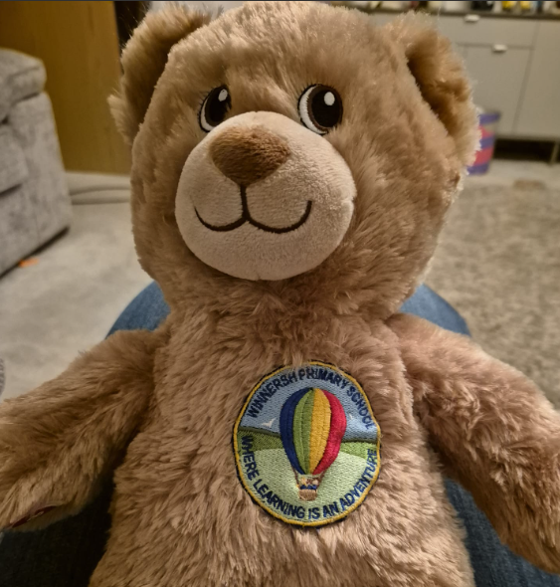
Travelling Ted
E
Every week a child will get to bring Ted home with them. This is an opportunity for your child to engage in some activities with Ted and then take photos of these activities to share with their peers.
Activities do not need to be extravagant; they can simply be cuddled up reading stories, playing in the garden, helping with cooking or a walk to the park etc.
A book will be provided for you to stick photos in and to write a few short sentences about the adventures.
We will send Ted home on a Friday, and he needs to be returned by the Tuesday.

Slide 21
We hope you have found all the information helpful. Please talk to one of us if you need to let us know anything about your child. You can also send a message via the enquiries email. enquiries@winnersh.wokingham.sch.uk

